Slide 1
Image Enhancement and Filter in Spatial Domain

Slide 2
What Is Image Enhancement?
Image enhancement is the process of making images more useful
The reasons for doing this include:
Highlighting interesting detail in images
Removing noise from images
Making images more visually appealing
Notes:
2

Slide 3
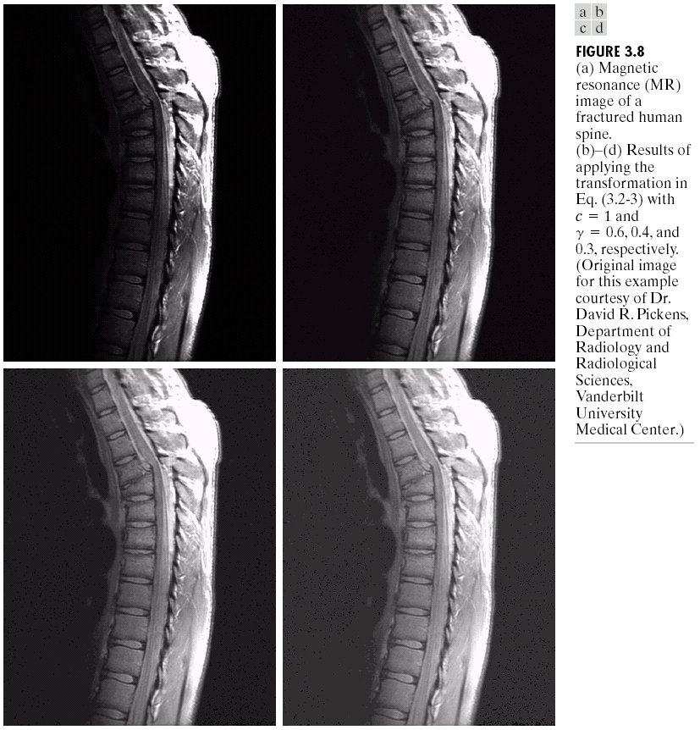

Image Enhancement Examples
Images taken from Gonzalez & Woods, Digital Image Processing (2002)
Notes:
3

Slide 4
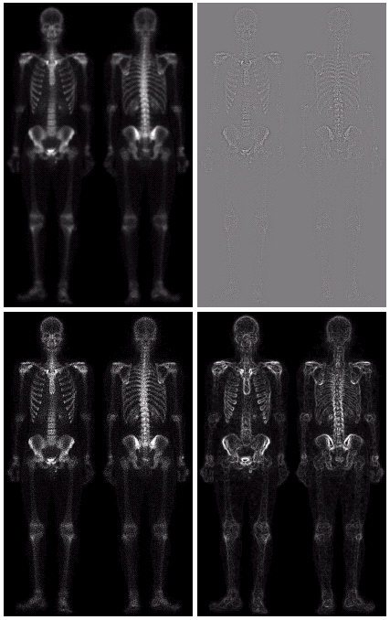
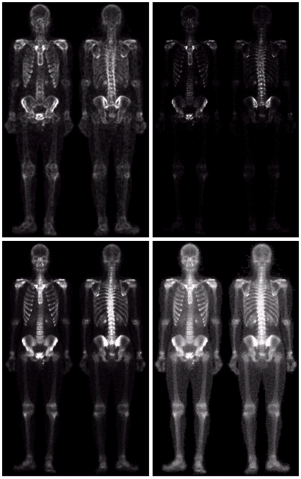
Image Enhancement Examples (cont…)
Images taken from Gonzalez & Woods, Digital Image Processing (2002)
Notes:
4

Slide 5
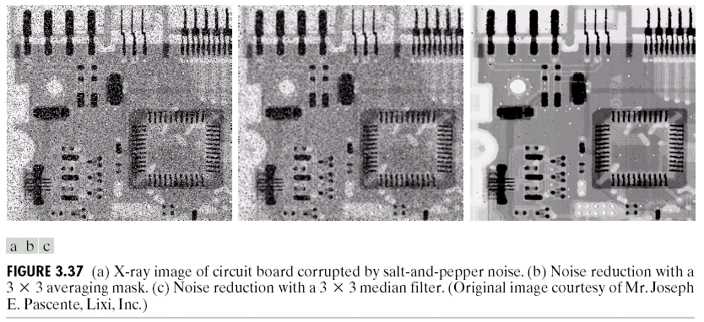
Image Enhancement Examples (cont…)
Images taken from Gonzalez & Woods, Digital Image Processing (2002)
Notes:
5

Slide 6
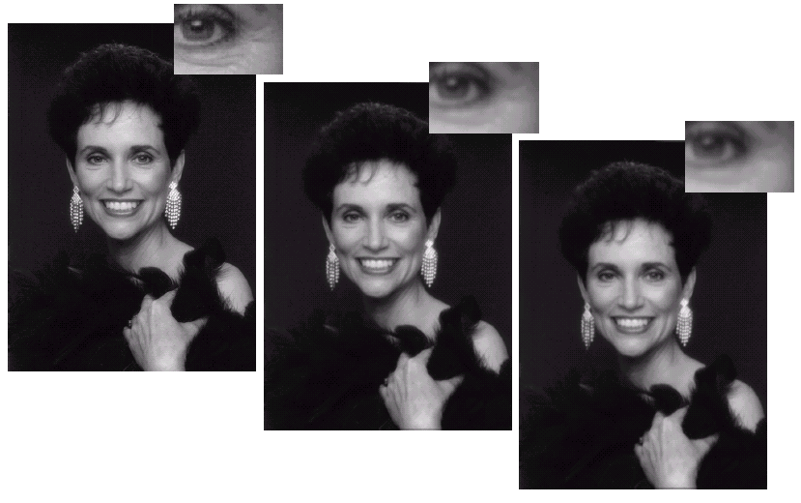
Image Enhancement Examples (cont…)
Images taken from Gonzalez & Woods, Digital Image Processing (2002)
Notes:
6

Slide 7
Spatial & Frequency Domains
There are two broad categories of image enhancement techniques
Spatial domain techniques
Direct manipulation of image pixels
Frequency domain techniques
Manipulation of Fourier transform or wavelet transform of an image
For the moment we will concentrate on techniques that operate in the spatial domain
Notes:
7

Slide 8
Basic Spatial Domain Image Enhancement
Most spatial domain enhancement operations can be reduced to the form
g (x, y) = T[ f (x, y)]
where f (x, y) is the input image, g (x, y) is the processed image and T is some operator defined over some neighbourhood of (x, y)
Origin
x
(x, y)
y
Image f (x, y)
Notes:
8

Slide 9
Point Processing
The simplest spatial domain operations occur when the neighbourhood is simply the pixel itself
In this case T is referred to as a grey level transformation function or a point processing operation
Point processing operations take the form
s = T ( r )
where s refers to the processed image pixel value and r refers to the original image pixel value
Notes:
9

Slide 10
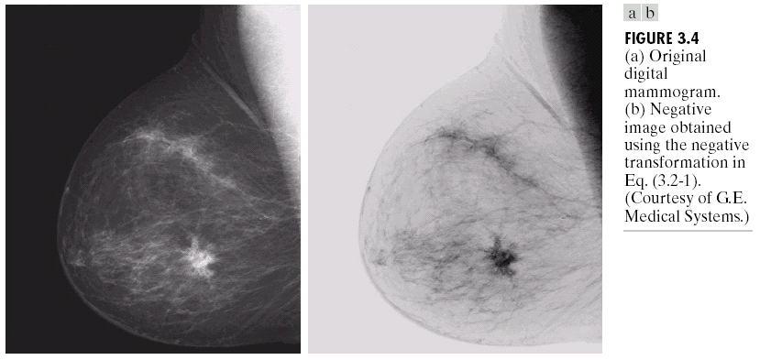
Point Processing Example: Negative Images
Negative images are useful for enhancing white or grey detail embedded in dark regions of an image
Note how much clearer the tissue is in the negative image of the mammogram below
Images taken from Gonzalez & Woods, Digital Image Processing (2002)
Original Image
s = 1.0 - r
Negative Image
Notes:
10

Slide 11
Point Processing Example: Negative Images (cont…)
Original Image
x
Enhanced Image
x
y
Image f (x, y)
y
Image f (x, y)
s = intensity_{max} - r
Notes:
11

Slide 12
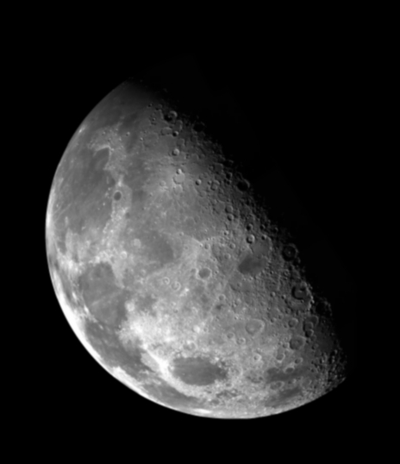

Point Processing Example: Thresholding
Thresholding transformations are particularly useful for segmentation in which we want to isolate an object of interest from a background
Images taken from Gonzalez & Woods, Digital Image Processing (2002)
1.0
r > threshold
s =
0.0
r <= threshold
Notes:
12

Slide 13
Point Processing Example: Thresholding (cont…)
Original Image
x
Enhanced Image
x
y
Image f (x, y)
y
Image f (x, y)
1.0 r > threshold
s =
0.0 r <= threshold
Notes:
13

Slide 14
Intensity Transformations
Images taken from Gonzalez & Woods, Digital Image Processing (2002)

Slide 15
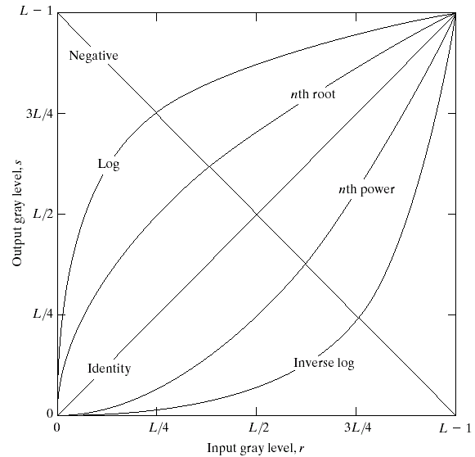
Basic Grey Level Transformations
There are many different kinds of grey level transformations
Three of the most common are shown here
Linear
Negative/Identity
Logarithmic
Log/Inverse log
Power law
n^{th} power/n^{th} root
Images taken from Gonzalez & Woods, Digital Image Processing (2002)
Notes:
15

Slide 16
Logarithmic Transformations
The general form of the log transformation is
s = c * log(1 + r)
The log transformation maps a narrow range of low input grey level values into a wider range of output values
The inverse log transformation performs the opposite transformation
Compresses the dynamic range of images with large variations in pixel values
Notes:
16

Slide 17
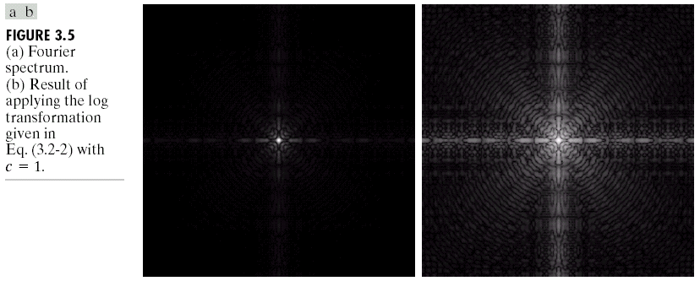
Logarithmic Transformations (cont…)
Log functions are particularly useful when the input grey level values may have an extremely large range of values
In the following example the Fourier transform of an image is put through a log transform to reveal more detail
Images taken from Gonzalez & Woods, Digital Image Processing (2002)
s = log(1 + r)
Notes:
17

Slide 18
Logarithmic Transformations (cont…)
Original Image
x
Enhanced Image
x
y
Image f (x, y)
y
Image f (x, y)
s = log(1 + r)
We usually set c to 1
Grey levels must be in the range [0.0, 1.0]
Notes:
18

Slide 19
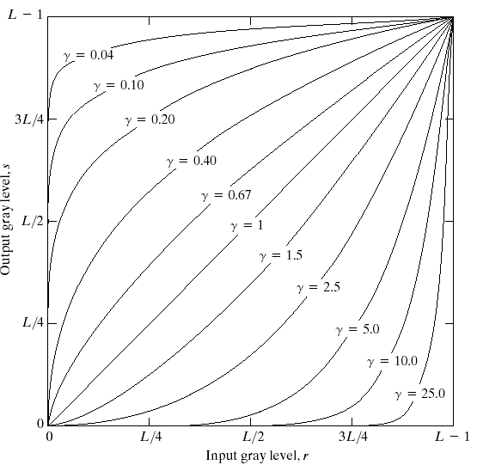
Power Law Transformations
Power law transformations have the following form
s = c * r ^{γ}
Map a narrow range of dark input values into a wider range of output values or vice versa
Varying γ gives a whole family of curves
Images taken from Gonzalez & Woods, Digital Image Processing (2002)
Notes:
19

Slide 20
Power Law Transformations (cont…)
Original Image
x
Enhanced Image
x
y
Image f (x, y)
y
Image f (x, y)
s = r ^{γ}
We usually set c to 1
Grey levels must be in the range [0.0, 1.0]
Notes:
20

Slide 21
Power Law Example
Notes:
21

Slide 22
Power Law Example (cont…)
γ = 0.6
Notes:
22

Slide 23
Power Law Example (cont…)
γ = 0.4
Notes:
23

Slide 24
Power Law Example (cont…)
γ = 0.3
Notes:
24

Slide 25
Power Law Example (cont…)
The images to the right show a magnetic resonance (MR) image of a fractured human spine
Different curves highlight different detail
s = r ^{0.6}
s = r ^{0.3}
s = r ^{0.4}
Images taken from Gonzalez & Woods, Digital Image Processing (2002)
Notes:
25
The third transform is a step too far

Slide 26
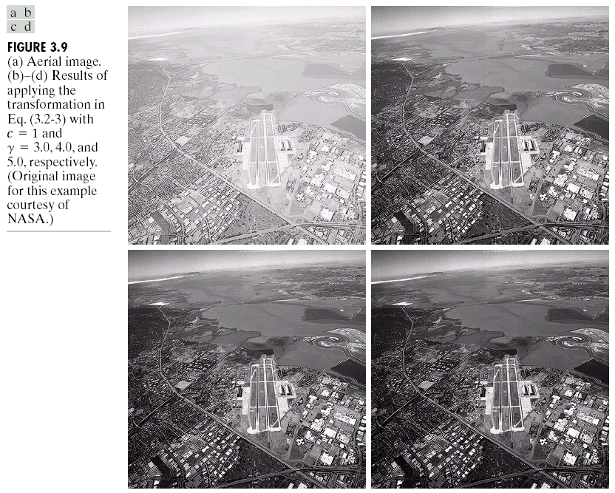
Power Law Example
Notes:
26

Slide 27
Power Law Example (cont…)
γ = 5.0
Notes:
27

Slide 28
Power Law Transformations (cont…)
An aerial photo of a runway is shown
This time power law transforms are used to darken the image
Different curves highlight different detail
s = r ^{3.0}
s = r ^{4.0}
s = r ^{5.0}
Images taken from Gonzalez & Woods, Digital Image Processing (2002)
Notes:
28

Slide 29
Gamma Correction
Many devices used for image capture, display and printing respond according to a power law
• The exponent in the power-law equation is referred to as gamma
• The process of correcting for the power-law response is referred to as gamma correction
• Example: – CRT devices have an intensity-to-voltage response that is
a power function (exponents typically range from 1.8-2.5)
– Gamma correction in this case could be achieved by applying the transformation s=r1/2.5=r^0.4
Notes:
29

Slide 30
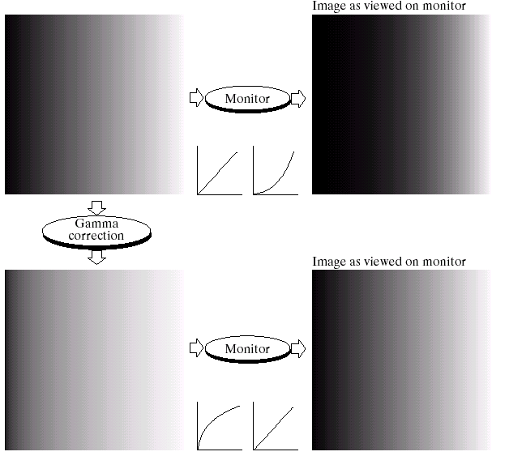
Gamma Correction
Many of you might be familiar with gamma correction of computer monitors
Problem is that display devices do not respond linearly to different intensities
Can be corrected using a log transform
Images taken from Gonzalez & Woods, Digital Image Processing (2002)
Notes:
30

Slide 31
More Contrast Issues
Images taken from Gonzalez & Woods, Digital Image Processing (2002)

Slide 32
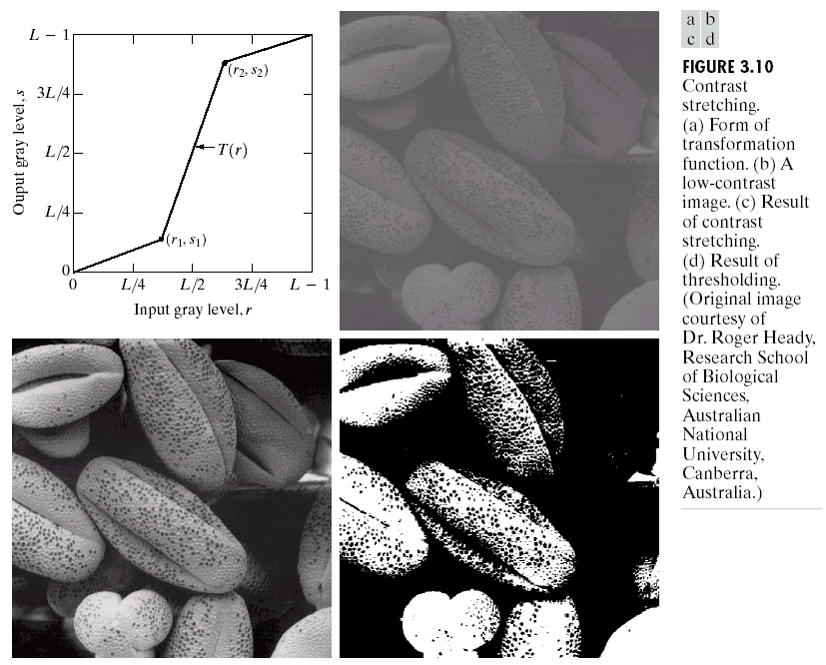
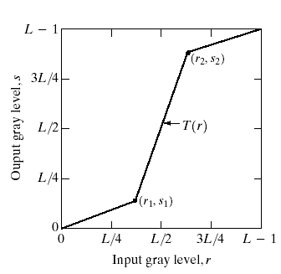
Piecewise Linear Transformation Functions
Rather than using a well defined mathematical function we can use arbitrary user-defined transforms
The images below show a contrast stretching linear transform to add contrast to a poor quality image
Images taken from Gonzalez & Woods, Digital Image Processing (2002)
Notes:
32

Slide 33
Piecewise Linear Transformation Functions
• Rather than using a well defined mathematical function we can use arbitrary user-defined transforms
• Contrast stretching expands the range of intensity levels in an image so it spans a given (full) intensity range
• Control points (r1,s1) and (r2,s2) control the shape of the transform T(r)
• r1=r2, s1=0 and s2=L-1 yields a thresholding function
The contrast stretched image shown in the previous slide is obtained using the transformation obtained from the equation of the line having following points
• (r1,s1)=(rmin,0) and (r2, s2)=(rmax,L-1)
Images taken from Gonzalez & Woods, Digital Image Processing (2002)
Notes:
33

Slide 34
Gray Level Slicing
• Used to highlight a specific range of intensities in an image that might be of interest
•Two common approaches
– Set all pixel values within a range of interest to one value (white) and all others to another value (black)
Produces a binary image
– Brighten (or darken) pixel values in a range of interest and leave all others unchanged
Images taken from Gonzalez & Woods, Digital Image Processing (2002)
Notes:
34

Slide 35
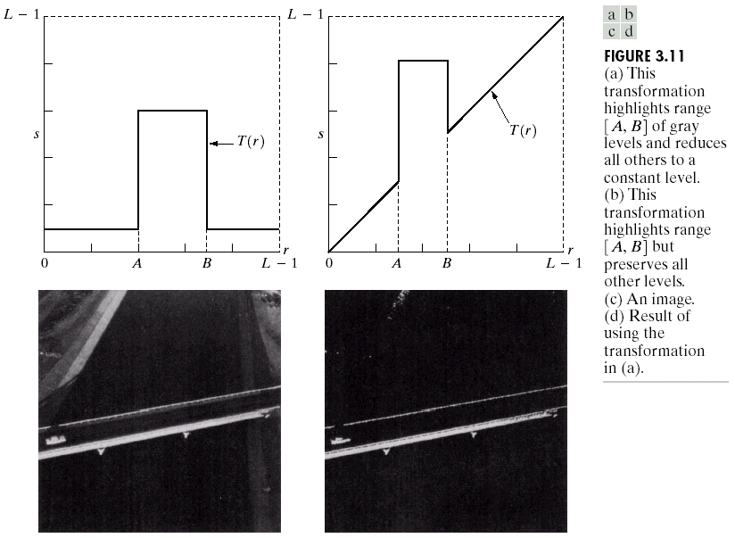
Gray Level Slicing
Highlights a specific range of grey levels
Similar to thresholding
Other levels can be suppressed or maintained
Useful for highlighting features in an image
Images taken from Gonzalez & Woods, Digital Image Processing (2002)
Notes:
35

Slide 36
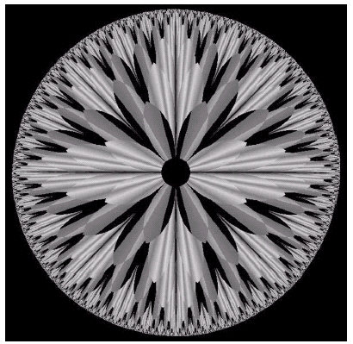
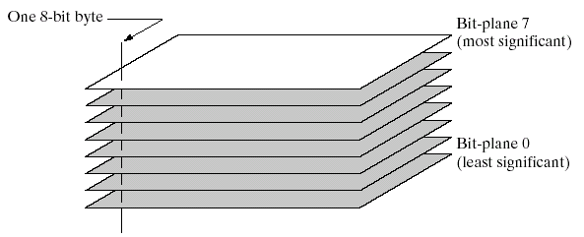
Bit Plane Slicing
Often by isolating particular bits of the pixel values in an image we can highlight interesting aspects of that image
Higher-order bits usually contain most of the significant visual information
Lower-order bits contain subtle details
Images taken from Gonzalez & Woods, Digital Image Processing (2002)
Notes:
36

Slide 37
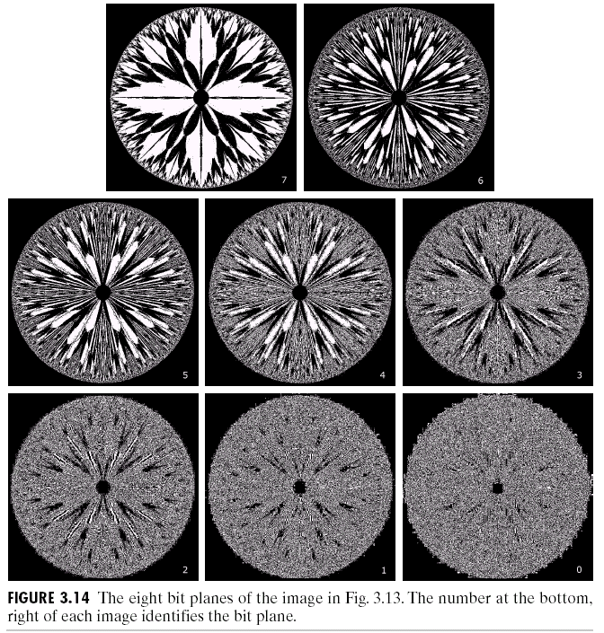
Bit Plane Slicing (cont…)
[10000000]
[01000000]
[00100000]
[00001000]
Images taken from Gonzalez & Woods, Digital Image Processing (2002)
[00000100]
[00000001]
Notes:
37

Slide 38
Bit Plane Slicing (cont…)
[10000000]
[01000000]
[00100000]
[00001000]
Images taken from Gonzalez & Woods, Digital Image Processing (2002)
[00000100]
[00000001]
Notes:
38

Slide 39
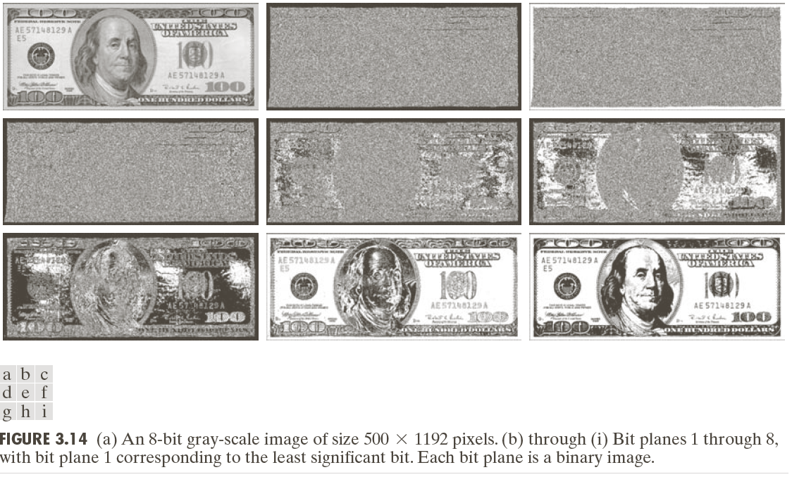
Bit Plane Slicing (cont…)
Notes:
39

Slide 40
Bit Plane Slicing (cont…)
Images taken from Gonzalez & Woods, Digital Image Processing (2002)
Notes:
40

Slide 41
Bit Plane Slicing (cont…)
Images taken from Gonzalez & Woods, Digital Image Processing (2002)
Notes:
41

Slide 42
Bit Plane Slicing (cont…)
Images taken from Gonzalez & Woods, Digital Image Processing (2002)
Notes:
42

Slide 43
Bit Plane Slicing (cont…)
Images taken from Gonzalez & Woods, Digital Image Processing (2002)
Notes:
43

Slide 44
Bit Plane Slicing (cont…)
Images taken from Gonzalez & Woods, Digital Image Processing (2002)
Notes:
44

Slide 45
Bit Plane Slicing (cont…)
Images taken from Gonzalez & Woods, Digital Image Processing (2002)
Notes:
45

Slide 46
Bit Plane Slicing (cont…)
Images taken from Gonzalez & Woods, Digital Image Processing (2002)
Notes:
46

Slide 47
Bit Plane Slicing (cont…)
Images taken from Gonzalez & Woods, Digital Image Processing (2002)
Notes:
47

Slide 48
Bit Plane Slicing (cont…)
Images taken from Gonzalez & Woods, Digital Image Processing (2002)
Notes:
48

Slide 49
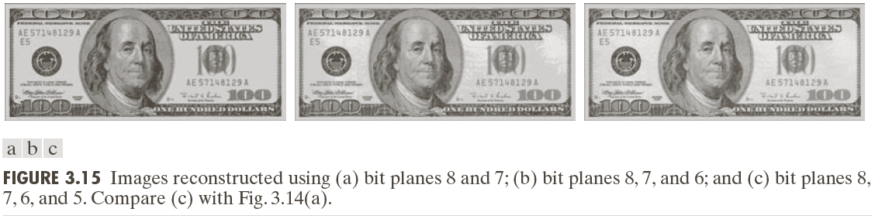
Bit Plane Slicing (cont…)
Reconstructed image using only bit planes 8 and 7
Reconstructed image using only bit planes 8, 7 and 6
Images taken from Gonzalez & Woods, Digital Image Processing (2002)
Reconstructed image using only bit planes 7, 6 and 5
Notes:
49

Slide 50
Image Histograms
The histogram of an image shows us the distribution of grey levels in the image
Massively useful in image processing, especially in segmentation
Frequencies
Grey Levels
Notes:
50

Slide 51
Image Histograms
• The histogram of a digital image, f, (with intensities [0,L-1]) is a discrete function
h(rk) = nk
• Where rk is the kth intensity value and nk is the number of
pixels in f with intensity rk
• Normalizing the histogram is common practice – Divide the components by the total number of pixels in the image – Assuming an MxN image, this yields
p(rk) = nk/MN for k=0,1,2,....,L-1 – p(rk) is, basically, an estimate of the probability of occurrence of intensity level rk in an image Σ p(rk) = 1
Notes:
51

Slide 52
Uses for Histogram Processing
• Image enhancements
• Image statistics
• Image compression
• Image segmentation
• Simple to calculate in software
• Economic hardware implementations
– Popular tool in real-time image processing
• A plot of this function for all values of k provides a global description of the appearance of the image (gives useful information for contrast enhancement)
• Histograms commonly viewed in plots as
h(rk) = nk versus rk
p(rk) = nk /MN versus rk
Notes:
52

Slide 53
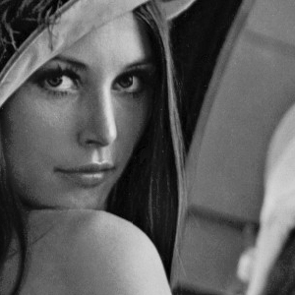
Histogram Examples
Images taken from Gonzalez & Woods, Digital Image Processing (2002)
Notes:
53

Slide 54
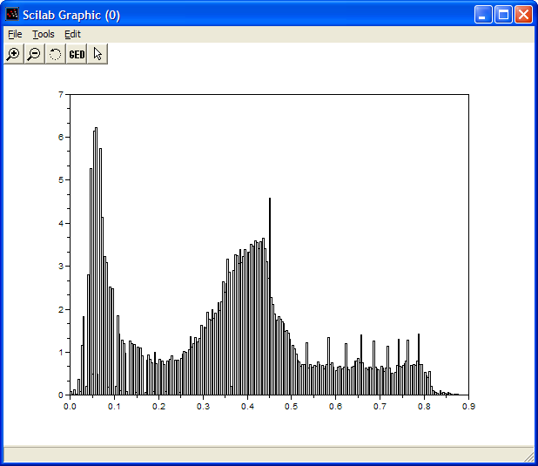
Histogram Examples (cont…)
Images taken from Gonzalez & Woods, Digital Image Processing (2002)
Notes:
54

Slide 55
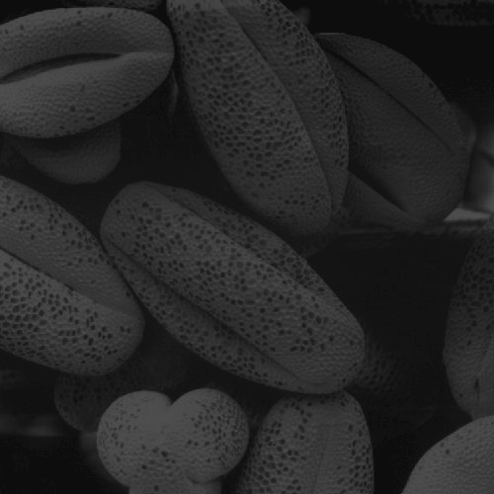
Histogram Examples (cont…)
Images taken from Gonzalez & Woods, Digital Image Processing (2002)
Notes:
55

Slide 56
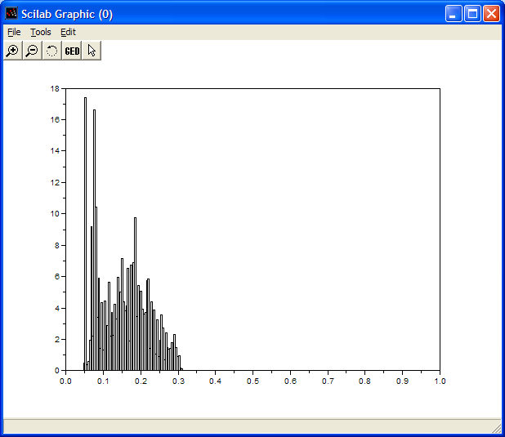
Histogram Examples (cont…)
Images taken from Gonzalez & Woods, Digital Image Processing (2002)
Notes:
56

Slide 57
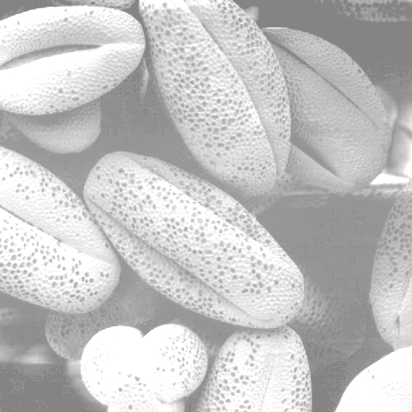
Histogram Examples (cont…)
Images taken from Gonzalez & Woods, Digital Image Processing (2002)
Notes:
57

Slide 58
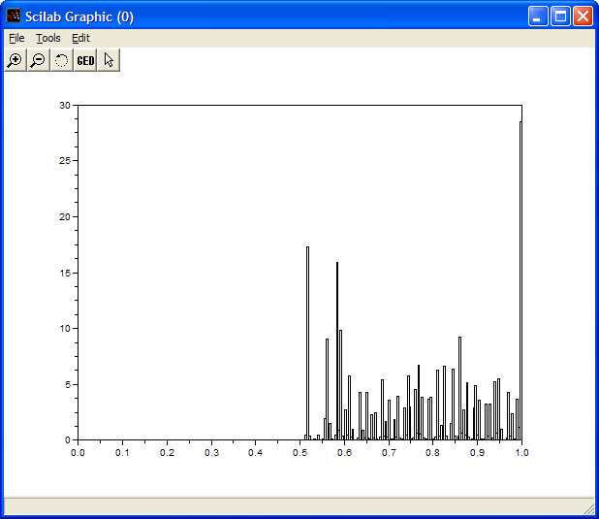
Histogram Examples (cont…)
Images taken from Gonzalez & Woods, Digital Image Processing (2002)
Notes:
58

Slide 59

Histogram Examples (cont…)
Images taken from Gonzalez & Woods, Digital Image Processing (2002)
Notes:
59

Slide 60
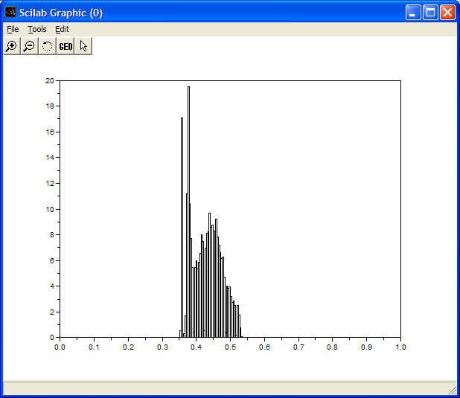
Histogram Examples (cont…)
Images taken from Gonzalez & Woods, Digital Image Processing (2002)
Notes:
60

Slide 61
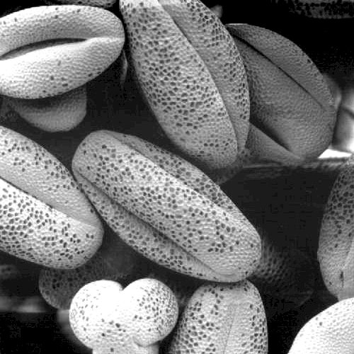
Histogram Examples (cont…)
Images taken from Gonzalez & Woods, Digital Image Processing (2002)
Notes:
61

Slide 62
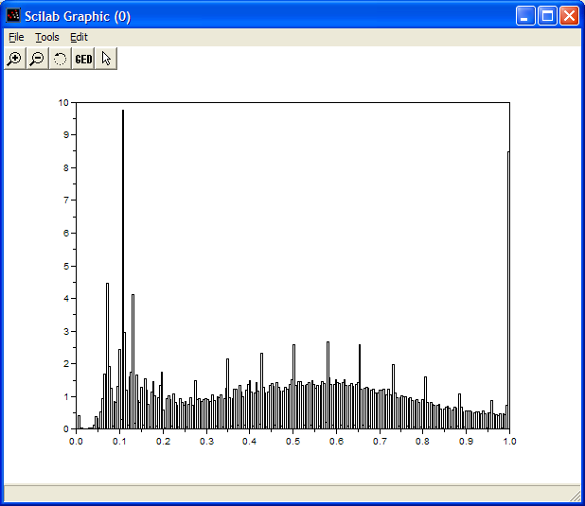
Histogram Examples (cont…)
Images taken from Gonzalez & Woods, Digital Image Processing (2002)
Notes:
62

Slide 63
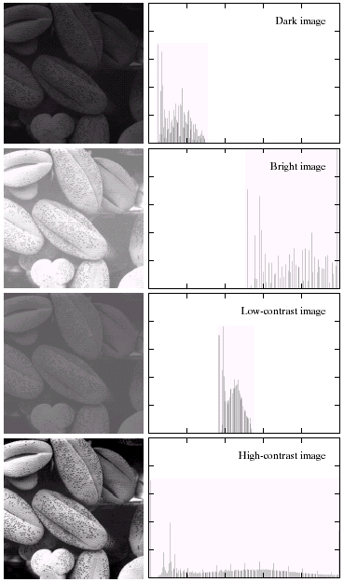
Histogram Examples (cont…)
A selection of images and their histograms
Notice the relationships between the images and their histograms
Note that the high contrast image has the most evenly spaced histogram
Images taken from Gonzalez & Woods, Digital Image Processing (2002)
Notes:
63

Slide 64
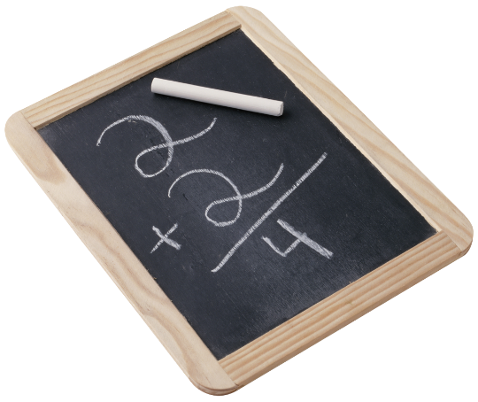
Contrast Stretching
We can fix images that have poor contrast by applying a pretty simple contrast specification
The interesting part is how do we decide on this transformation function?

Slide 65
Histogram Equalisation
• Histogram equalization is a process for increasing the contrast in an image by spreading the histogram out to be approximately uniformly distributed
• The gray levels of an image that has been subjected to histogram equalization are spread out and always reach white
– The increase of dynamic range produces an increase in contrast
• For images with low contrast, histogram equalization has the adverse effect of increasing visual graininess
Notes:
65

Slide 66
Histogram Equalisation
• The intensity transformation function we are constructing is of the form
s=T(r) 0 ≤ r ≤ L−1
• An output intensity level s is produced for every pixel in the input image having intensity r
• We assume
– T(r) is monotonically increasing in the interval 0≤ r ≤ L-1
– 0 ≤ Τ(r) ≤ L-1 for 0 ≤ r ≤ L-1
• If we define the inverse
r=T^−1(s) 0 ≤ s ≤ L−1
• Then T(r) should be strictly monotonically increasing
Notes:
66

Slide 67
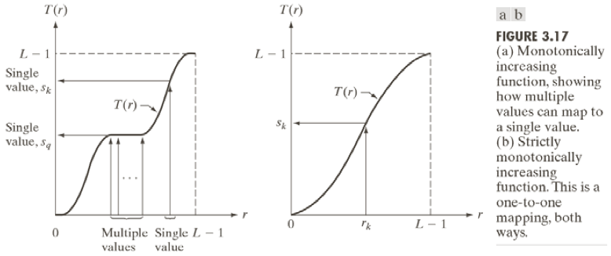
Histogram Equalisation
Notes:
67

Slide 68

Histogram Equalisation
• Histogram equalization requires construction of a transformation function sk
• where rk is the kth gray level, nk is the number of pixels with that gray level, MxN is the number of pixels in the image, and k=0,1,...,L-1
• This yields an s with as many elements as the original image’s histogram (normally 256 for our test images)
• The values of s will be in the range [0,1]. For constructing a new image, s would be scaled to the range [1,256]
Notes:
68

Slide 69
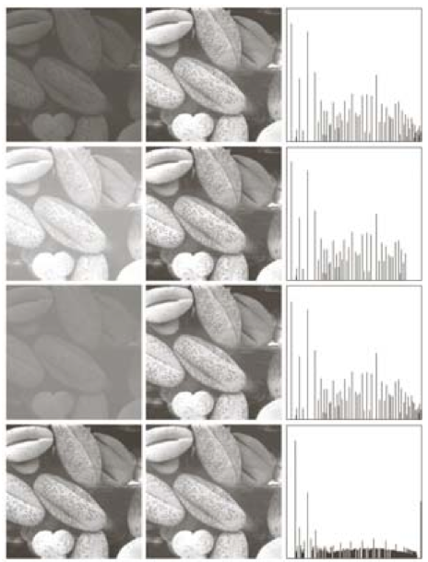
Histogram Equalisation
Notes:
69

Slide 70
Histogram Equalisation
Spreading out the frequencies in an image (or equalising the image) is a simple way to improve dark or washed out images
The formula for histogram equalisation is given where
r_{k}: input intensity
s_{k}: processed intensity
k: the intensity range (e.g 0.0 – 1.0)
n_{j}: the frequency of intensity j
n: the sum of all frequencies
The transformation function in the next slide is
Obtained by applying the RHS formula to the
Original image in the next side.
Notes:
70

Slide 71
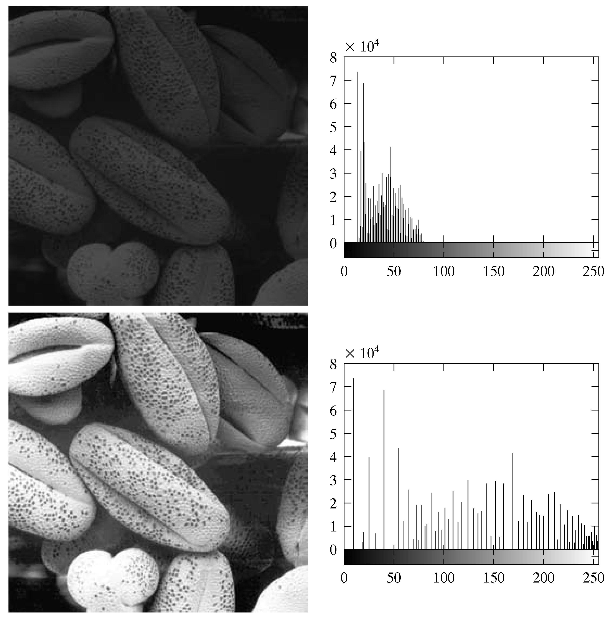
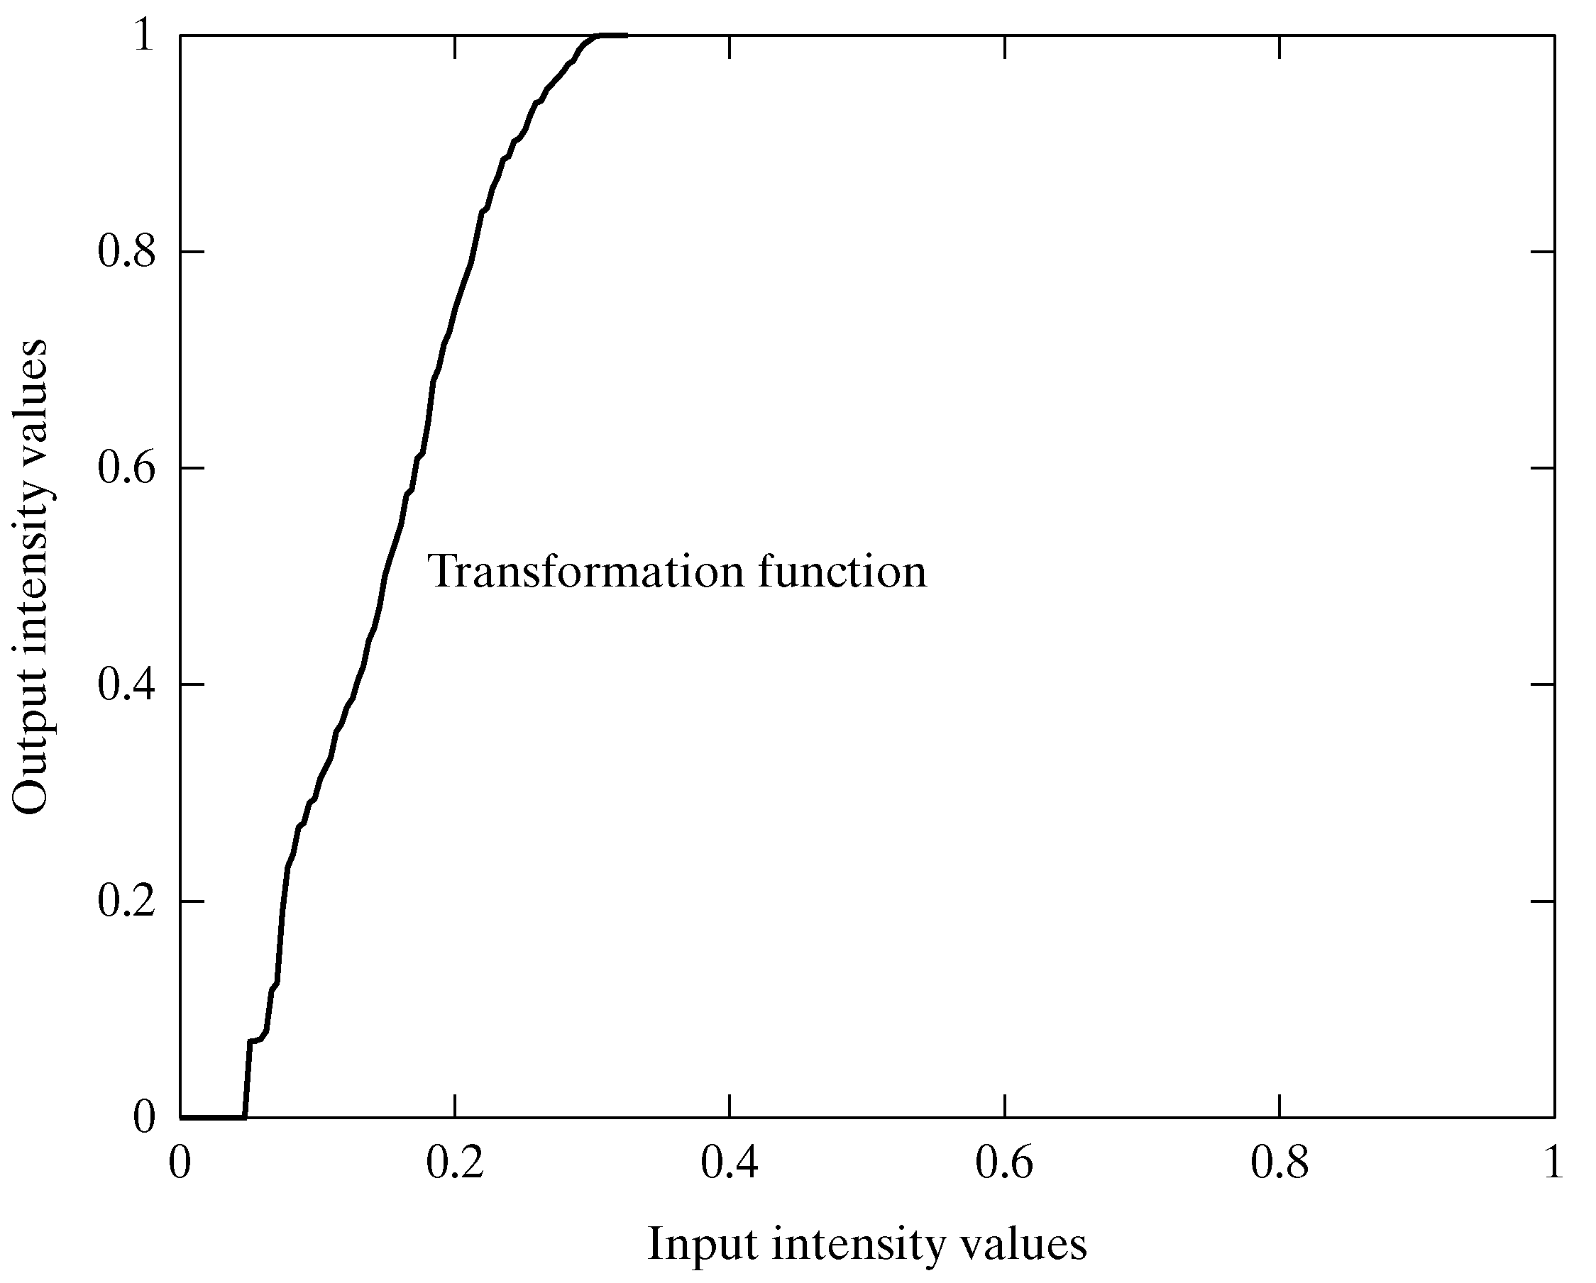
Equalisation Transformation Function
Images taken from Gonzalez & Woods, Digital Image Processing (2002)
Notes:
71

Slide 72
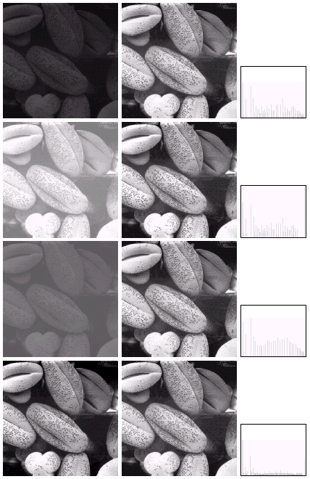
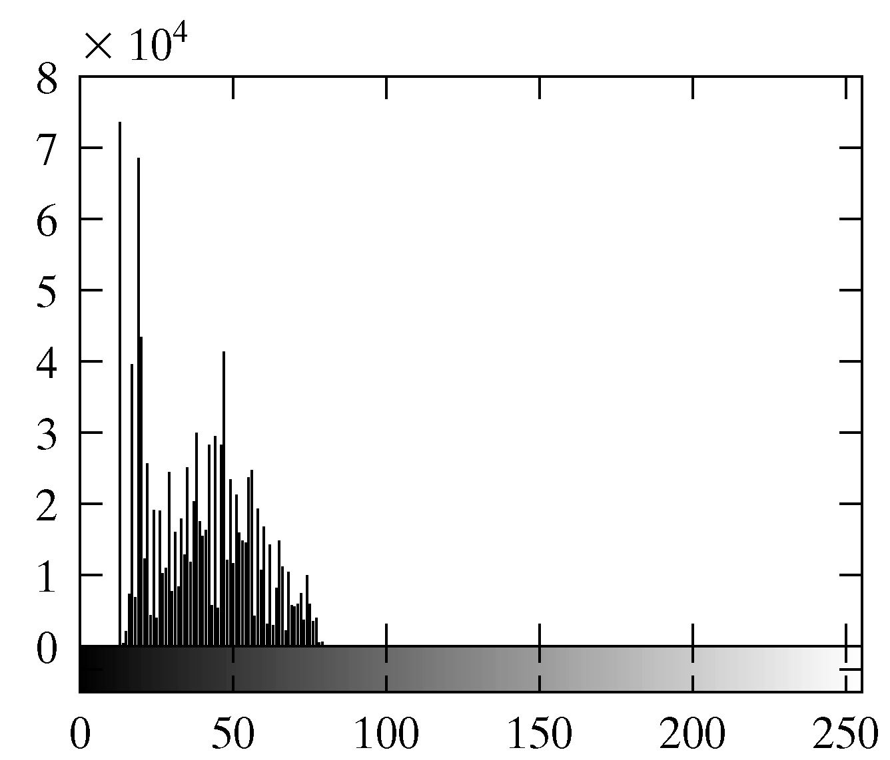
Equalisation Examples
1
Images taken from Gonzalez & Woods, Digital Image Processing (2002)
Notes:
72

Slide 73
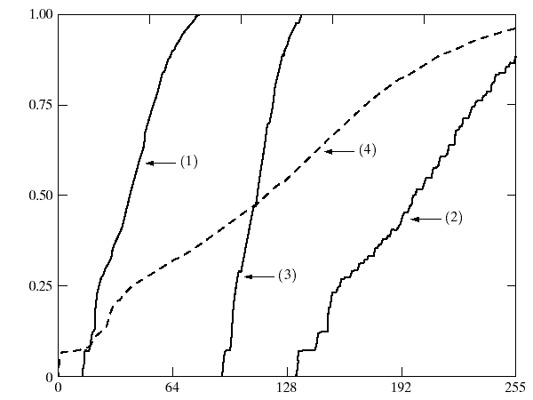
Equalisation Transformation Functions
The functions used to equalise the images in the previous example
Images taken from Gonzalez & Woods, Digital Image Processing (2002)
Notes:
73

Slide 74
Equalisation Examples
2
Images taken from Gonzalez & Woods, Digital Image Processing (2002)
Notes:
74

Slide 75
Equalisation Transformation Functions
The functions used to equalise the images in the previous example
Images taken from Gonzalez & Woods, Digital Image Processing (2002)
Notes:
75

Slide 76
Equalisation Examples (cont…)
3
Images taken from Gonzalez & Woods, Digital Image Processing (2002)
4
Notes:
76

Slide 77
Equalisation Examples (cont…)
3
Images taken from Gonzalez & Woods, Digital Image Processing (2002)
4
Notes:
77

Slide 78
Equalisation Transformation Functions
The functions used to equalise the images in the previous examples
Images taken from Gonzalez & Woods, Digital Image Processing (2002)
Notes:
78

Slide 79
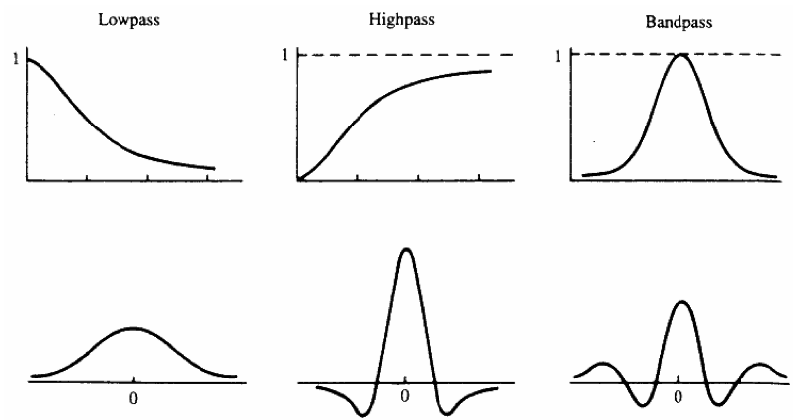
Spatial Filtering
• Filters in the frequency domain and corresponding spatial filters
• Basic approach is to sum products between mask coefficients and pixel values
– R=w1z1 +w2z2 +....+w9z9
Notes:
79

Slide 80
Order-Statistic nonlinear spatial filters
• Nonlinear spatial filters also operate on neighborhoods
• Their operation is based directly on pixel values in the neighborhood under consideration
– They do not explicitly use coefficient values as in the linear spatial filters
• Example nonlinear spatial filters
– Median filter: Computes the median gray-level value of the neighborhood. Used for noise reduction.
– Max filter: Used to find the brightest points in an image
R=max{zk |k=1,2,...,9}
– Min filter: Used to find the dimmest points in an image
R=min{zk |k=1,2,...,9}
Notes:
80

Slide 81
Neighbourhood Operations
Neighbourhood operations simply operate on a larger neighbourhood of pixels than point operations
Neighbourhoods are mostly a rectangle around a central pixel
Any size rectangle and any shape filter are possible
Origin
x
(x, y)
Neighbourhood
y
Image f (x, y)
Notes:
81

Slide 82
Simple Neighbourhood Operations
Some simple neighbourhood operations include:
Min: Set the pixel value to the minimum in the neighbourhood
Max: Set the pixel value to the maximum in the neighbourhood
Median: The median value of a set of numbers is the midpoint value in that set (e.g. from the set [1, 7, 15, 18, 24] 15 is the median). Sometimes the median works better than the average
Notes:
82

Slide 83
Simple Neighbourhood Operations Example
Original Image
x
Enhanced Image
x
123
127
128
119
115
130
140
145
148
153
167
172
133
154
183
192
194
191
194
199
207
210
198
195
164
170
175
162
173
151
y
y
Notes:
83

Slide 84
The Spatial Filtering Process
Origin
x
a
b
c
r
s
t
d
e
f
*
u
v
w
g
h
i
x
y
z
Original Image Pixels
Filter
Simple 3*3 Neighbourhood
e
3*3 Filter
e_{processed} = v*e + r*a + s*b + t*c + u*d + w*f + x*g + y*h + z*i
y
Image f (x, y)
The above is repeated for every pixel in the original image to generate the filtered image
Notes:
84

Slide 85
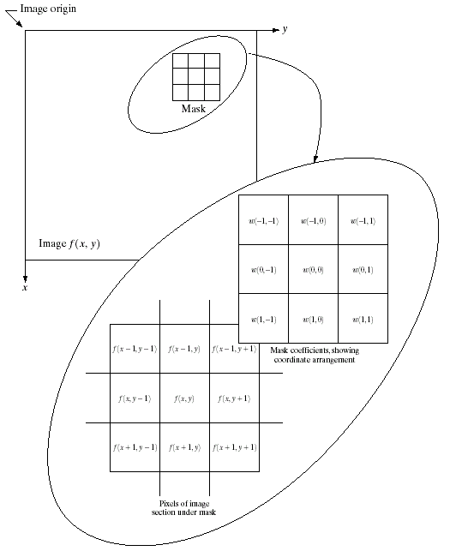

Spatial Filtering: Equation Form
Filtering can be given in equation form as shown above
Notations are based on the image shown to the left
Images taken from Gonzalez & Woods, Digital Image Processing (2002)
Notes:
85

Slide 86
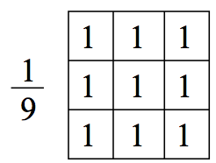
Smoothing Spatial Filters
• The shape of the impulse response needed to implement a lowpass (smoothing) filter indicates the filter should have all positive coefficients
• For a 3x3 mask, the simplest arrangement is to have all the coefficient values equal to one (neighborhood averaging)
– The response would be the sum of all gray levels for the nine pixels in the mask
– This could cause the value of R to be out of the valid gray-level range
• The solution is to scale the result by dividing by 9
Notes:
86

Slide 87
Smoothing Spatial Filters
One of the simplest spatial filtering operations we can perform is a smoothing operation
Simply average all of the pixels in a neighbourhood around a central value
Especially useful in removing noise from images
Also useful for highlighting gross detail
¹/₉ | ¹/₉ | ¹/₉
¹/₉ | ¹/₉ | ¹/₉
¹/₉ | ¹/₉ | ¹/₉
Simple averaging filter
Notes:
87

Slide 88
Smoothing Spatial Filtering
Origin
x
104
100
108
¹/₉
¹/₉
¹/₉
99
106
98
*
¹/₉
¹/₉
¹/₉
95
90
85
¹/₉
¹/₉
¹/₉
Original Image Pixels
Filter
¹/₉
¹/₉
¹/₉
Simple 3*3 Neighbourhood
104
100
108
3*3 Smoothing Filter
¹/₉
¹/₉
¹/₉
99
106
98
¹/₉
¹/₉
¹/₉
95
90
85
e = ¹/₉*106 + ¹/₉*104 + ¹/₉*100 + ¹/₉*108 + ¹/₉*99 + ¹/₉*98 + ¹/₉*95 + ¹/₉*90 + ¹/₉*85
= 98.3333
y
Image f (x, y)
The above is repeated for every pixel in the original image to generate the smoothed image
Notes:
88

Slide 89
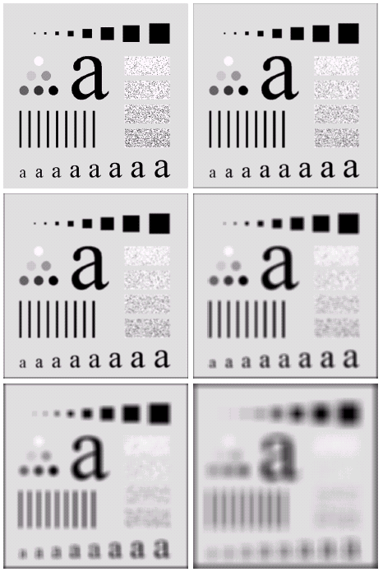
Image Smoothing Example
The image at the top left is an original image of size 500*500 pixels
The subsequent images show the image after filtering with an averaging filter of increasing sizes
3, 5, 9, 15 and 35
Notice how detail begins to disappear
Images taken from Gonzalez & Woods, Digital Image Processing (2002)
Notes:
89

Slide 90
Image Smoothing Example
Images taken from Gonzalez & Woods, Digital Image Processing (2002)
Notes:
90

Slide 91
Image Smoothing Example
Images taken from Gonzalez & Woods, Digital Image Processing (2002)
Notes:
91

Slide 92
Image Smoothing Example
Images taken from Gonzalez & Woods, Digital Image Processing (2002)
Notes:
92

Slide 93
Image Smoothing Example
Images taken from Gonzalez & Woods, Digital Image Processing (2002)
Notes:
93

Slide 94
Image Smoothing Example
Images taken from Gonzalez & Woods, Digital Image Processing (2002)
Notes:
94

Slide 95
Image Smoothing Example
Images taken from Gonzalez & Woods, Digital Image Processing (2002)
Notes:
95

Slide 96
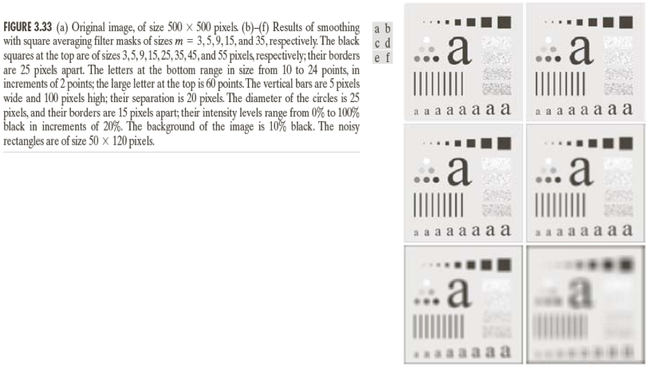
Image Smoothing Example
Images taken from Gonzalez & Woods, Digital Image Processing (2002)
Notes:
96

Slide 97
Weighted Smoothing Filters
More effective smoothing filters can be generated by allowing different pixels in the neighbourhood different weights in the averaging function
Pixels closer to the central pixel are more important
Often referred to as a weighted averaging
¹/₁₆ | ²/₁₆ | ¹/₁₆
²/₁₆ | ⁴/₁₆ | ²/₁₆
¹/₁₆ | ²/₁₆ | ¹/₁₆
Weighted averaging filter
Notes:
97

Slide 98
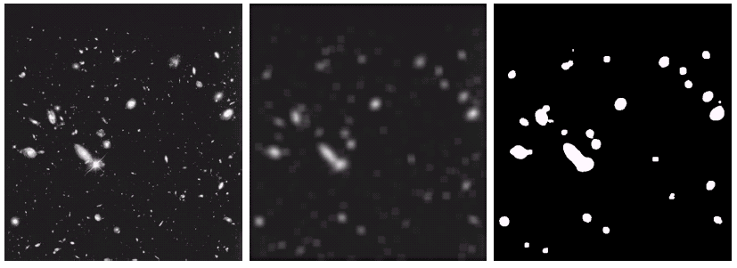
Another Smoothing Example
By smoothing the original image we get rid of lots of the finer detail which leaves only the gross features for thresholding
Images taken from Gonzalez & Woods, Digital Image Processing (2002)
Original Image
Smoothed Image
Thresholded Image
Notes:
98

Slide 99
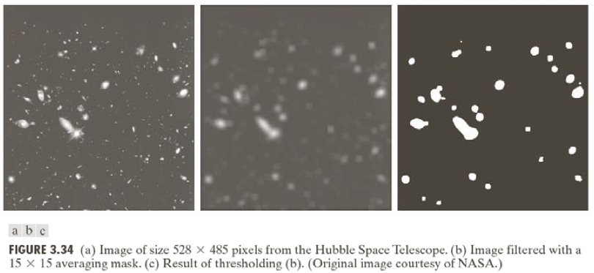
Another Smoothing Example
Images taken from Gonzalez & Woods, Digital Image Processing (2002)
Notes:
99

Slide 100
Smoothing Filters
• One problem with the lowpass filter is it blurs edges and other sharp details
• If the intent is to achieve noise reduction, one approach can be to use median filtering
– The value of each pixel is replaced by the median pixel value in the neighborhood (as opposed to the average)
– Particularly effective when the noise consists of strong, spike like components and edge sharpness is to be preserved
• The median m of a set of values is such that half of the values are greater than m and half are less than m
• To implement, sort the pixel values in the neighborhood, choose the median and assign this value to the pixel of interest
• Forces pixels with distinct intensities to be more like their neighbors
Notes:
100

Slide 101
Averaging Filter Vs. Median Filter Example
Original Image With Noise
Image After Averaging Filter
Image After Median Filter
Images taken from Gonzalez & Woods, Digital Image Processing (2002)
Filtering is often used to remove noise from images
Sometimes a median filter works better than an averaging filter
Notes:
101

Slide 102
Averaging Filter Vs. Median Filter Example
Images taken from Gonzalez & Woods, Digital Image Processing (2002)
Notes:
102

Slide 103
Averaging Filter Vs. Median Filter Example
Images taken from Gonzalez & Woods, Digital Image Processing (2002)
Notes:
103

Slide 104
Averaging Filter Vs. Median Filter Example
Images taken from Gonzalez & Woods, Digital Image Processing (2002)
Notes:
104

Slide 105
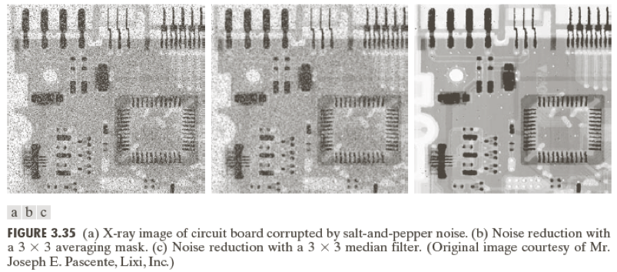
Averaging Filter Vs. Median Filter Example
Images taken from Gonzalez & Woods, Digital Image Processing (2002)
Notes:
105

Slide 106
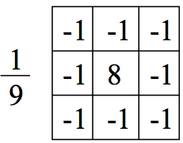
Sharpening Filters (High Pass)
• The shape of the impulse response needed to implement a high-pass (sharpening) filter indicates the filter should have positive coefficients near its center and negative coefficients in the outer periphery
• For a 3x3 mask, the simplest arrangement is to have the center coefficient positive and all others negative
Notes:
106

Slide 107
Sharpening Filters (High Pass)
• Note the sum of the coefficients is zero
– When the mask is over a constant or slowly varying region the output is zero or very small
• This filter eliminates the zero-frequency term
• Eliminating this term reduces the average gray-level value in the image to zero (will reduce the global contrast of the image)
• Result will be a some what edge-enhanced image over a dark background
• Reducing the average gray-level value to zero implies some negative gray levels
– The output should be scaled back into an appropriate range
[0, L-1]
Notes:
107

Slide 108
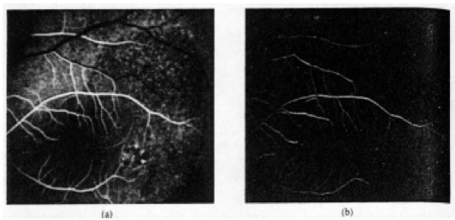
Sharpening Filters (High Pass)
Notes:
108

Slide 109
Sharpening Filters (High-boost)
• A high-pass filter may be computed as:
High-pass = Original - Lowpass
• Multiplying the original by an amplification factor yields a high-boost or high-frequency-emphasis filter
High-boost = A(Original) − Lowpass
= ( A − 1)(Original ) + Original − Lowpass
= ( A − 1)(Original ) + High-pass
– If A>1, part of the original image is added to the high-pass result
(partially restoring low frequency components)
– Result looks more like the original image with a relative degree of edge enhancement that depends on the value of A
– May be implemented with the center coefficient value w=9A-1 (A≥1)
Notes:
109

Slide 110
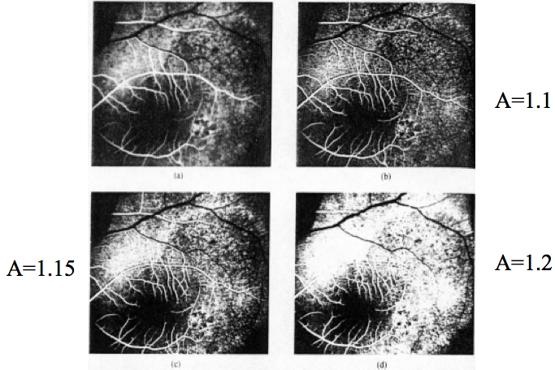
Sharpening Filters (High-boost)
Notes:
110

Slide 111
Simple Neighbourhood Operations Example
x
123
127
128
119
115
130
140
145
148
153
167
172
133
154
183
192
194
191
194
199
207
210
198
195
164
170
175
162
173
151
y
Notes:
111

Slide 112
Strange Things Happen At The Edges!
At the edges of an image we are missing pixels to form a neighbourhood
Origin
x
e
e
e
e
e
e
e
y
Image f (x, y)
Notes:
112

Slide 113
Strange Things Happen At The Edges! (cont…)
There are a few approaches to dealing with missing edge pixels:
Omit missing pixels
Only works with some filters
Can add extra code and slow down processing
Pad the image
Typically with either all white or all black pixels
Replicate border pixels
Truncate the image
Allow pixels wrap around the image
Can cause some strange image artefacts
Notes:
113

Slide 114
Simple Neighbourhood Operations Example
x
123
127
128
119
115
130
140
145
148
153
167
172
133
154
183
192
194
191
194
199
207
210
198
195
164
170
175
162
173
151
y
Notes:
114

Slide 115




Strange Things Happen At The Edges! (cont…)
Filtered Image: Zero Padding
Original Image
Filtered Image: Replicate Edge Pixels
Images taken from Gonzalez & Woods, Digital Image Processing (2002)
Filtered Image: Wrap Around Edge Pixels
Notes:
115

Slide 116
Strange Things Happen At The Edges! (cont…)
Images taken from Gonzalez & Woods, Digital Image Processing (2002)
Notes:
116

Slide 117
Strange Things Happen At The Edges! (cont…)
Images taken from Gonzalez & Woods, Digital Image Processing (2002)
Notes:
117

Slide 118
Strange Things Happen At The Edges! (cont…)
Images taken from Gonzalez & Woods, Digital Image Processing (2002)
Notes:
118

Slide 119
Correlation & Convolution
The filtering we have been talking about so far is referred to as correlation with the filter itself referred to as the correlation kernel
Convolution is a similar operation, with just one subtle difference
For symmetric filters it makes no difference
a
b
c
r
s
t
e_{processed} = v*e + z*a + y*b + x*c + w*d + u*e + t*f + s*g + r*h
d
e
e
*
u
v
w
f
g
h
x
y
z
Original Image Pixels
Filter
Notes:
119

Slide 120
Spatial Filtering Refresher
Origin
x
a
b
c
r
s
t
d
e
f
*
u
v
w
g
h
i
x
y
z
Original Image Pixels
Filter
Simple 3*3 Neighbourhood
e
3*3 Filter
e_{processed} = v*e + r*a + s*b + t*c + u*d + w*f + x*g + y*h + z*i
y
Image f (x, y)
The above is repeated for every pixel in the original image to generate the smoothed image
Notes:
120

Slide 121
Sharpening Spatial Filters
Previously we have looked at smoothing filters which remove fine detail
Sharpening spatial filters seek to highlight fine detail
Remove blurring from images
Highlight edges
Sharpening filters are based on spatial differentiation
Notes:
121

Slide 122
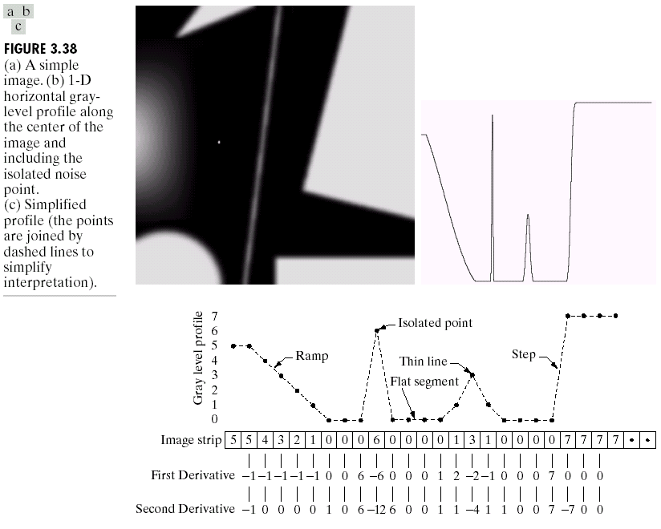
Spatial Differentiation
Differentiation measures the rate of change of a function
Let’s consider a simple 1 dimensional example
Images taken from Gonzalez & Woods, Digital Image Processing (2002)
Notes:
122

Slide 123
Spatial Differentiation
A
B
Images taken from Gonzalez & Woods, Digital Image Processing (2002)
Notes:
123

Slide 124
1st Derivative
The formula for the 1st derivative of a function is as follows:
It’s just the difference between subsequent values and measures the rate of change of the function
Notes:
124

Slide 125


1st Derivative (cont…)
5 | 5 | 4 | 3 | 2 | 1 | 0 | 0 | 0 | 6 | 0 | 0 | 0 | 0 | 1 | 3 | 1 | 0 | 0 | 0 | 0 | 7 | 7 | 7 | 7
 | 0 | -1 | -1 | -1 | -1 | 0 | 0 | 6 | -6 | 0 | 0 | 0 | 1 | 2 | -2 | -1 | 0 | 0 | 0 | 7 | 0 | 0 | 0
Notes:
125

Slide 126
2nd Derivative
The formula for the 2nd derivative of a function is as follows:
Simply takes into account the values both before and after the current value
Notes:
126

Slide 127


2nd Derivative (cont…)
5 | 5 | 4 | 3 | 2 | 1 | 0 | 0 | 0 | 6 | 0 | 0 | 0 | 0 | 1 | 3 | 1 | 0 | 0 | 0 | 0 | 7 | 7 | 7 | 7
 | -1 | 0 | 0 | 0 | 0 | 1 | 0 | 6 | -12 | 6 | 0 | 0 | 1 | 1 | -4 | 1 | 1 | 0 | 0 | 7 | -7 | 0 | 0
Notes:
127

Slide 128
Using Second Derivatives For Image Enhancement
The 2nd derivative is more useful for image enhancement than the 1st derivative
Stronger response to fine detail
Simpler implementation
We will come back to the 1st order derivative later on
The first sharpening filter we will look at is the Laplacian
Isotropic
One of the simplest sharpening filters
We will look at a digital implementation
Notes:
128

Slide 129
The Laplacian
The Laplacian is defined as follows:
where the partial 1st order derivative in the x direction is defined as follows:
and in the y direction as follows:
Notes:
129

Slide 130
The Laplacian (cont…)
So, the Laplacian can be given as follows:
We can easily build a filter based on this
0
1
0
1
-4
1
0
1
0
Notes:
130

Slide 131

The Laplacian (cont…)
Applying the Laplacian to an image we get a new image that highlights edges and other discontinuities
Images taken from Gonzalez & Woods, Digital Image Processing (2002)
Original Image
Laplacian Filtered Image
Laplacian Filtered Image Scaled for Display
Notes:
131

Slide 132
But That Is Not Very Enhanced!
The result of a Laplacian filtering is not an enhanced image
We have to do more work in order to get our final image
Subtract the Laplacian result from the original image to generate our final sharpened enhanced image
Images taken from Gonzalez & Woods, Digital Image Processing (2002)
Laplacian Filtered Image Scaled for Display
Notes:
132

Slide 133
Laplacian Image Enhancement
-
=
Original Image
Laplacian Filtered Image
Sharpened Image
Images taken from Gonzalez & Woods, Digital Image Processing (2002)
In the final sharpened image edges and fine detail are much more obvious
Notes:
133

Slide 134
Laplacian Image Enhancement
Images taken from Gonzalez & Woods, Digital Image Processing (2002)
Notes:
134

Slide 135
Simplified Image Enhancement
The entire enhancement can be combined into a single filtering operation
Notes:
135

Slide 136

Simplified Image Enhancement (cont…)
This gives us a new filter which does the whole job for us in one step
0
-1
0
-1
5
-1
Images taken from Gonzalez & Woods, Digital Image Processing (2002)
0
-1
0
Notes:
136

Slide 137
Simplified Image Enhancement (cont…)
Images taken from Gonzalez & Woods, Digital Image Processing (2002)
Notes:
137

Slide 138
Variants On The Simple Laplacian
There are lots of slightly different versions of the Laplacian that can be used:
0
1
0
1
1
1
Simple Laplacian
Variant of Laplacian
1
-4
1
1
-8
1
0
1
0
1
1
1
Images taken from Gonzalez & Woods, Digital Image Processing (2002)
-1
-1
-1
-1
9
-1
-1
-1
-1
Notes:
138

Slide 139
1st Derivative Filtering
Implementing 1st derivative filters is difficult in practice
For a function f(x, y) the gradient of f at coordinates (x, y) is given as the column vector:
Notes:
139

Slide 140
1st Derivative Filtering (cont…)
The magnitude of this vector is given by:
For practical reasons this can be simplified as:
Notes:
140

Slide 141

1st Derivative Filtering (cont…)
Notes:
141

Slide 142

1st Derivative Filtering (cont…)
Notes:
142

Slide 143

1st Derivative Filtering (cont…)
Notes:
143

Slide 144

1st Derivative Filtering (cont…)
Notes:
144

Slide 145

1st Derivative Filtering (cont…)
Notes:
145

Slide 146

1st Derivative Filtering (cont…)
Notes:
146

Slide 147

1st Derivative Filtering (cont…)
Notes:
147

Slide 148

1st Derivative Filtering (cont…)
Notes:
148

Slide 149
1st Derivative Filtering (cont…)
There is some debate as to how best to calculate these gradients but we will use:
which is based on these coordinates
z₁
z₂
z₃
z₄
z₅
z₆
z₇
z₈
z₉
Notes:
149

Slide 150
Sobel Operators
Based on the previous equations we can derive the Sobel Operators
To filter an image it is filtered using both operators the results of which are added together
-1
-2
-1
-1
0
1
0
0
0
-2
0
2
1
2
1
-1
0
1
Notes:
150

Slide 151

Sobel Example
Sobel filters are typically used for edge detection
An image of a contact lens which is enhanced in order to make defects (at four and five o’clock in the image) more obvious
Images taken from Gonzalez & Woods, Digital Image Processing (2002)
Notes:
151

Slide 152
1st & 2nd Derivatives
Comparing the 1st and 2nd derivatives we can conclude the following:
1st order derivatives generally produce thicker edges
2nd order derivatives have a stronger response to fine detail e.g. thin lines
1st order derivatives have stronger response to grey level step
2nd order derivatives produce a double response at step changes in grey level
Notes:
152

Slide 153
Summary
In this lecture we looked at:
Sharpening filters
1st derivative filters
2nd derivative filters
Combining filtering techniques
Notes:
153

Slide 154
Combining Spatial Enhancement Methods
Successful image enhancement is typically not achieved using a single operation
Rather we combine a range of techniques in order to achieve a final result
This example will focus on enhancing the bone scan to the right
Images taken from Gonzalez & Woods, Digital Image Processing (2002)
Notes:
154

Slide 155
Combining Spatial Enhancement Methods (cont…)
(a)
Images taken from Gonzalez & Woods, Digital Image Processing (2002)
Laplacian filter of bone scan (a)
(b)
Sharpened version of bone scan achieved by subtracting (a) and (b)
(c)
Sobel filter of bone scan (a)
(d)
Notes:
155

Slide 156
Combining Spatial Enhancement Methods (cont…)
Result of applying a power-law trans. to (g)
(h)
Sharpened image which is sum of (a) and (f)
(g)
The product of (c) and (e) which will be used as a mask
(f)
(e)
Images taken from Gonzalez & Woods, Digital Image Processing (2002)
Image (d) smoothed with a 5*5 averaging filter
Notes:
156

Slide 157
Combining Spatial Enhancement Methods (cont…)
Compare the original and final images
Images taken from Gonzalez & Woods, Digital Image Processing (2002)
Notes:
157

